Slide 1



Operations & Algebraic Thinking
Grade 1
Gabriela Dumitrascu, Eastern Michigan University
Maggie Hackett, Sunnyside USD, Tucson, AZ
Cathy Kinzer, New Mexico State University

Slide 2
Objectives
The commutative property of addition starts in Kindergarten and continues up through 2nd grade
Description of learning experiences that support the students’ understanding of commutative property
Identify Standards of Mathematical Practice students engage in when exploring commutative property

Slide 3

We will …
Trace the progression of the application of the commutative property through the grade levels.
Examine an activity where students prove commutative property, and engage in mathematical practices.
Discuss the implications of students flexibly applying commutative property elsewhere in math.
Notes:
Outline of how we will address objectives.

Slide 4
Critical Areas
In Grade 1, instructional time should focus on four critical areas: (1) developing understanding of addition, subtraction, and strategies for addition and subtraction within 20
(1) They use properties of addition to add whole numbers and to create and use increasingly sophisticated strategies based on these properties (e.g., ―making tens) to solve addition and subtraction problems within 20. By comparing a variety of solution strategies, children build their understanding of the relationship between addition and subtraction.
Notes:
Look at cluster through the lens of critical areas and standards for mathematical practices – the STRUCTURE is the standard.

Slide 5
K.CC.4b. Understand that the last number name said tells the number of objects counted. The number of objects is the same regardless of their arrangement or the order in which they were counted.
K.OA.3. Decompose numbers less than or equal to 10 into pairs in more than one way, e.g., by using objects or drawings, and record each decomposition by a drawing or equation (e.g., 5=2+3 and 5=4+1).
Notes:
To create sophisticated strategies, they have to know the properties of addition – this builds from K with the idea of CC.4b., and applied with OA.3.

Slide 6
1.OA.3. Apply properties of operations as strategies to add and subtract.
1.OA.1 Use addition and subtraction within 20 to solve word problems involving situations of adding to, taking from, putting together, taking apart, and comparing, with unknowns in all positions, e.g., by using objects, drawings, and equations with a symbol for the unknown number to represent the problem.
1.OA.7. Understand the meaning of the equal sign, and determine if equations involving addition and subtraction are true or false.
Notes:
This is where all the magic happens!

Slide 7
2.OA.1. Use addition and subtraction within 100 to solve one- and two-step word problems involving situations of adding to, taking from, putting together, taking apart, and comparing, with unknowns in all positions, e.g., by using drawings and equations with a symbol for the unknown number to represent the problem.
Notes:
Properties need to be solidified by 2nd.

Slide 8
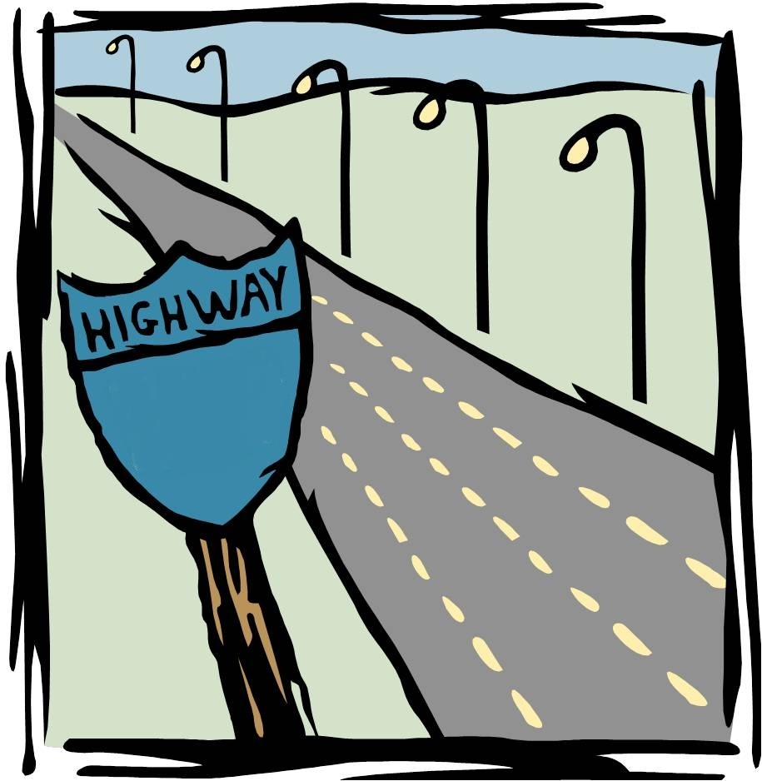
ALGEBRA
Arithmetic
Arithmetic
Arithmetic
Arithmetic
Arithmetic
Notes:
The arithmetic properties are essential for algebraic understanding.

Slide 9
In 6th grade, your students will be asked to…
Find the perimeter of a rectangle with a length of 30 in and a width of 75 in.
Write an expression that coincides with your procedure.
75 in
30 in
Notes:
Allow participants some time to work out this problem either indiv or in small groups. Share a few strategies, and as they are shared, identify uses of properties within the participants procedures.

Slide 10
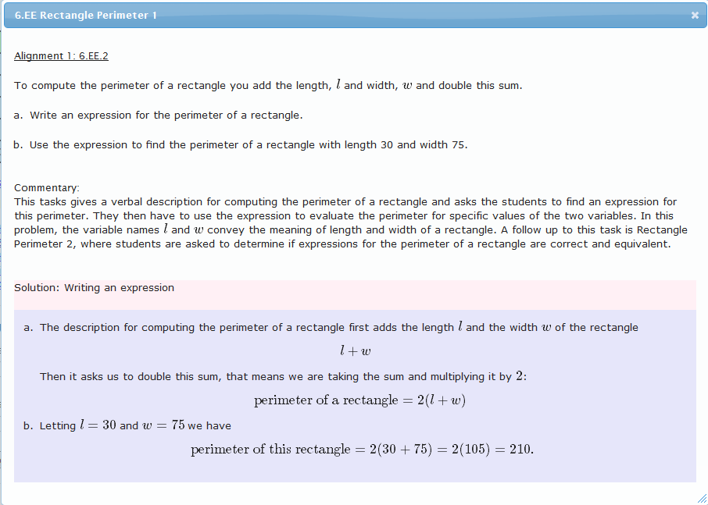
Notes:
Example from illustrativemathematics.org, where the properties are used in 6th grade context. 1st graders will need the flexibility of applying properties.

Slide 11
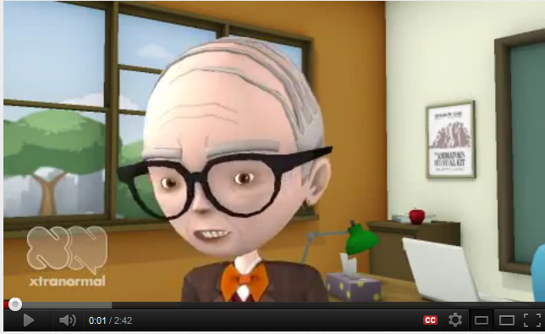
Teacher has…
Definitions
Examples
Mathematical Language
Generalization (rule)
All that’s missing is…
Student Understanding: why and where will I use this?
Notes:
Funny example of what might happen in a class. It technically has all the “right” elements of teaching, but student understanding is elusive.

Slide 12


What does this look like in the 1st grade classroom?

Slide 13

Notes:
Same idea….

Slide 14
Come up with two addends that equal 10.
_____ + _____ = 10
Notes:
Have participants create number sentences. Collect and discuss if they’ve exhausted possibilities – Commutative examples should come up, if not, pose that question to lead into investigation.

Slide 15
Notes:
“I wonder if placing 8 cubes first and then 2, will give me the same result (a balance of 10 cubes) as 2 cubes and then 8 cubes?” There is also an electronic version of this activity at http://illuminations.nctm.org/ActivityDetail.aspx?ID=26

Slide 16
Notes:
Other lesson connections to commutative property - Addition Facts ,Word Problems, Unknown numbers, Equality, Fact families, unifix trains, counters in a cup

Slide 17
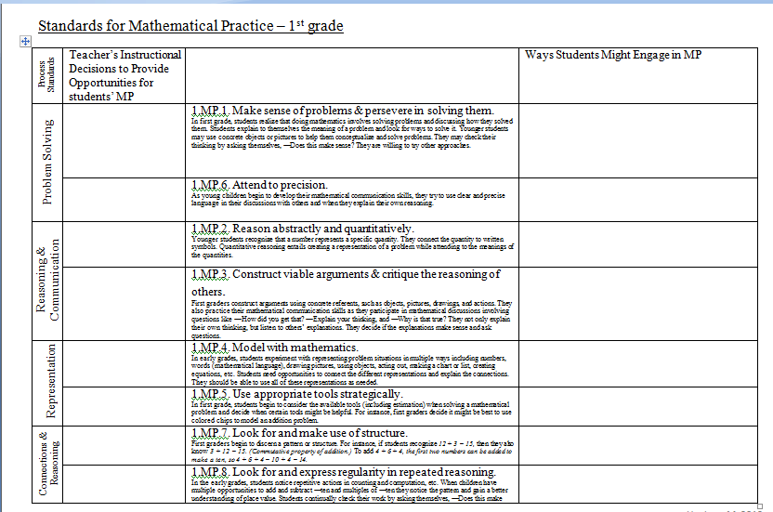
This lesson planning sheet is for you as the teacher to ensure you are providing opportunities for students to engage in the Standards for Mathematical Practices. You can make notes & reminders, and jot down questions that you might want to pose during a lesson to afford students the opportunity for a richer learning experience.
Notes:
In Dropbox – Have groups discuss what MPs are evident in the previous exploration into commutative prop.

Slide 18
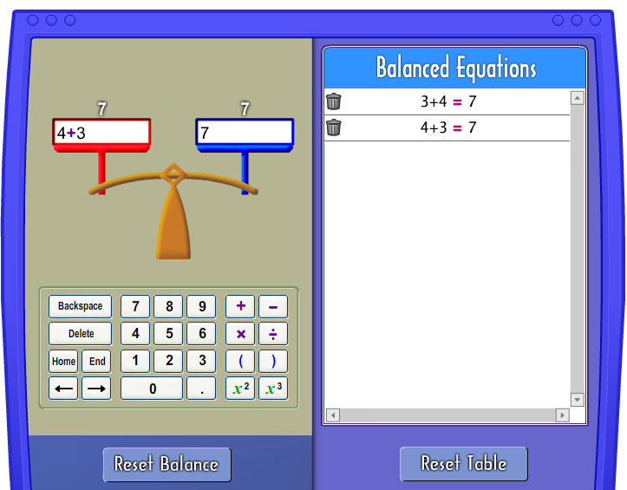
Illuminations has an electronic version of this activity.
Notes:
Click on the graphic to go to the Illuminations site.

Slide 19
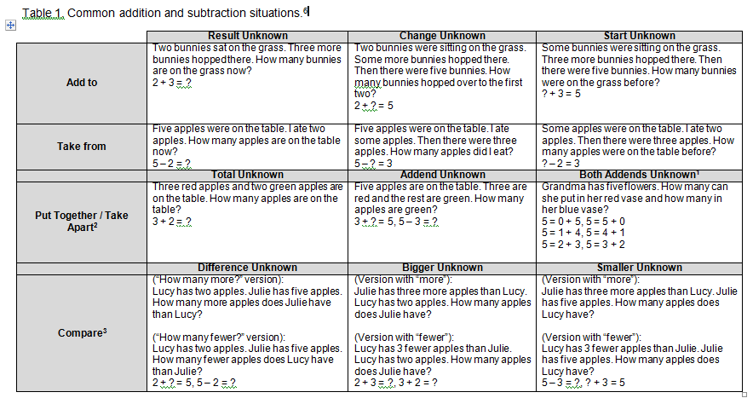
Now that we know why, let’s look at where the properties get applied.
Notes:
Commutative & Associative Properties help students solve the more difficult problems of “change unknown” and “start unknown”.

Slide 20
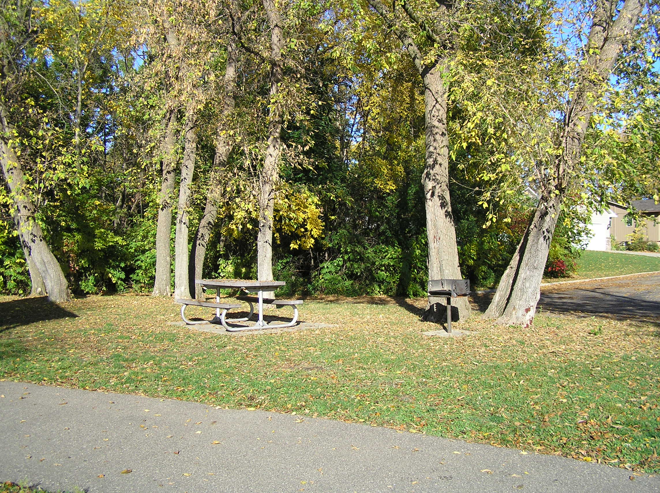
There were 5 children at the park. Then 8 more showed up. How many children were at the park?
There were 5 children at the park. Some more showed up. Then there were 13 children in all. How many more children came?
Some children were at the park. 8 more showed up. Then there were 13 children in all. How many children were at the park first?
Notes:
Have a discussion about what type of problems these are, and how commutative property could assist children in solving them.

Slide 21
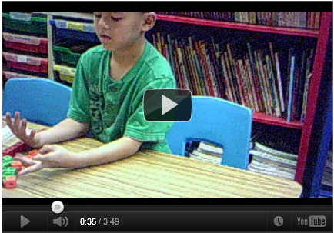
How is Cameron using the commutative property to assist calculating?
Notes:
Click on the picture to link to the video.

Slide 22
Summative Thoughts
The commutative and associative properties for addition of whole numbers allow computations to be performed flexibly. (Essential Understandings NCTM)
The standards for mathematical practices, should be addressed in both the planning, enacting, and reflecting on a lesson.
Notes:
It’s not that we’re forcing the MPs to happen, but you as the teacher have to provide the opportunities for the Mps to occur.
Refer back to learning goals – this slide recaps orig intent.

